Slide 1

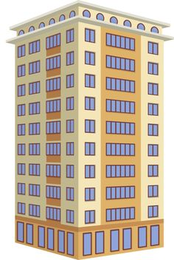
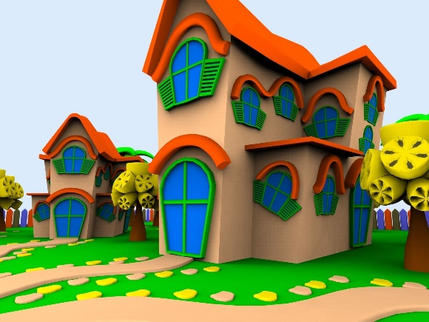
Analysing the most chosen area to stay based on particular factors(mainly price,location,bhk)
BY:
CHEKKARA SHRIJANI
PERECHARLA VENU

Slide 2

About us :
NAME : CHEKKARA SHRIJANI
QUALIFICATION : B.TECH
NAME : PERECHARLA VENU
QUALIFICATION : B.SC

Slide 3
Contents :
Introduction
Steps involved
Problem Statement
Tools (Libraries) used
Website URL’s for Web-Scrapping
Raw Data
Data Cleaning and Data Manipulation
Cleaned Data
EDA (Uni, Bi and Multi - variate Data analysis using graphs)
Observations
Challenges
Conclusion

Slide 4
Introduction :
We have choosen magic bricks website which is real estate website for scrapping the data.
Real estate definition is as follows: A type of real property with tangible assets. This includes land, buildings on the land, and improvements to the land, such as a roadway or private well.
In general real estate contains huge data and several factors influencing the properties demand in particular areas. We have chosen this website as we were able to perform web scrapping,and we got the rows and columns which we required.
We basically, took 400 records and 8 columns(price,location,tenant preferred,carpet area,floors,furnish,bathroom,bhk)
INTRODUCTION OF WEBSITE:
MagicBricks is a disruptive real-estate platform that makes it possible to buy/sell/rent a house without paying any brokerage
MagicBricks is a platform that removes this information asymmetry and provides a marketplace for free exchange of this information that used to cost 1-2 months of rent as brokerage.
We have done 2 things to help you find that perfect home:
Firstly, we have painstakingly verified each listing and made sure that these are direct owners or shared accommodation parties and there are no middlemen or brokers. We use lot of heuristics and techniques to ensure that you get a totally broker free list.
Thus, you can shortlist flats sitting at the comfort of your home without actually traveling all the good and bad properties.
This saves your time and effort and with a quick shortlist of 4-5 properties you can actually get a house in few hours! If you are a landlord interested in posting your apartments to MagicBricks, please email us at hello@MagicBricks.in and we will get in touch to help you list the property.

Slide 5
Steps involved in creating the Project
Working on Real Estate website magicbricks.com
Selecting particular locations for flats rent
Obtaining 8 columns like price , bhk , locations etc and 400 records
As our website has scrolling pages window we are using webdriver to obtain 400 records
To get particular column values we are using REGEX and CLASS,CONTAINERS
Converting 400x8 records,columns into dataframe , Creating Data Frame
Mapping the data columns of website to columns of data frame
reading csv file
Cleaning the data by removing SPECIAL CHARACTERS AND NULL VALUES
cleaning data with rupee symbol
cleaning data with Lac symbol
dropping unnecessary columns
checking values of dataframe
checking number of rows and columns
Removing outliers from data fram using minimum and maximum threshold of numerical values
upgrading seaborn,matplotlib libraries,importing libraries
upgrading seaborn library
upgrading matplotlib library
to remove unnecessary warnings
display 5 rows first
display 5 rows last
random 5 rows
UNIVARIANT ANALYSIS-HISTOGRAM, KERNAL DENSITY PLOT, COUNT PLOT, PIE-CHART, BAR PLOT, DISTRIBUTION PLOT, BOX-PLOT
BIVARIANT ANALYSIS-scatterplot, Histplot , violinplot , barplot , boxplot , heatmap
Multivariant analysis-pairplot, heatmap, scatterplot, regplot

Slide 6
Problem Statement :
Our problem statement is based on website which on daily basis for searching the houses,flats,apartments.Here our main focus for analysis is the best location to stay based on below mention factors,which we considered as our columns:
Price,bhk,location,carpetarea,
It is basically a real estate website called “MAGICBRICKS.COM”. It is designed basically on factors like price of the house,no. of bedrooms that is bhk,floors ,bathrooms,carpetarea,tenants preferred like bachelor,Bachelor/Family,Family,
Furnishing whether it is Fully furnished,Semi-Furnished and Unfurnished.
Illustrations of Analysis Peformed:
Analysis of correlation between the variables.
Analysis of House prices based on locations.
Analysis of highest count of location with more number of houses
Analysis of House prices based on bhk.
Analysis of tenant preferred on house price.
Analysis of house prices based on carpet area

Slide 7







Tools (Libraries) Used :
Requests
Beautiful Soup
Pandas
Numpy
Matplotlib
Seaborn
Plotly

Slide 8
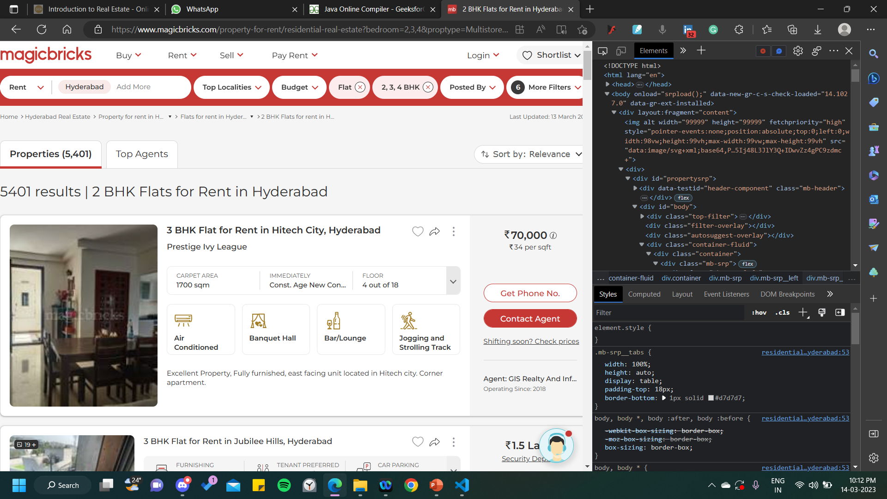
Website URL’s for Web-Scrapping :
https://www.magicbricks.com/property-for-rent/residential-real-estate?bedroom=2,3,4&proptype=MultistoreyApartment,
Builder-Floor-Apartment,Penthouse,Studio-Apartment,Service-Apartment&cityName=Hyderabad

Slide 9
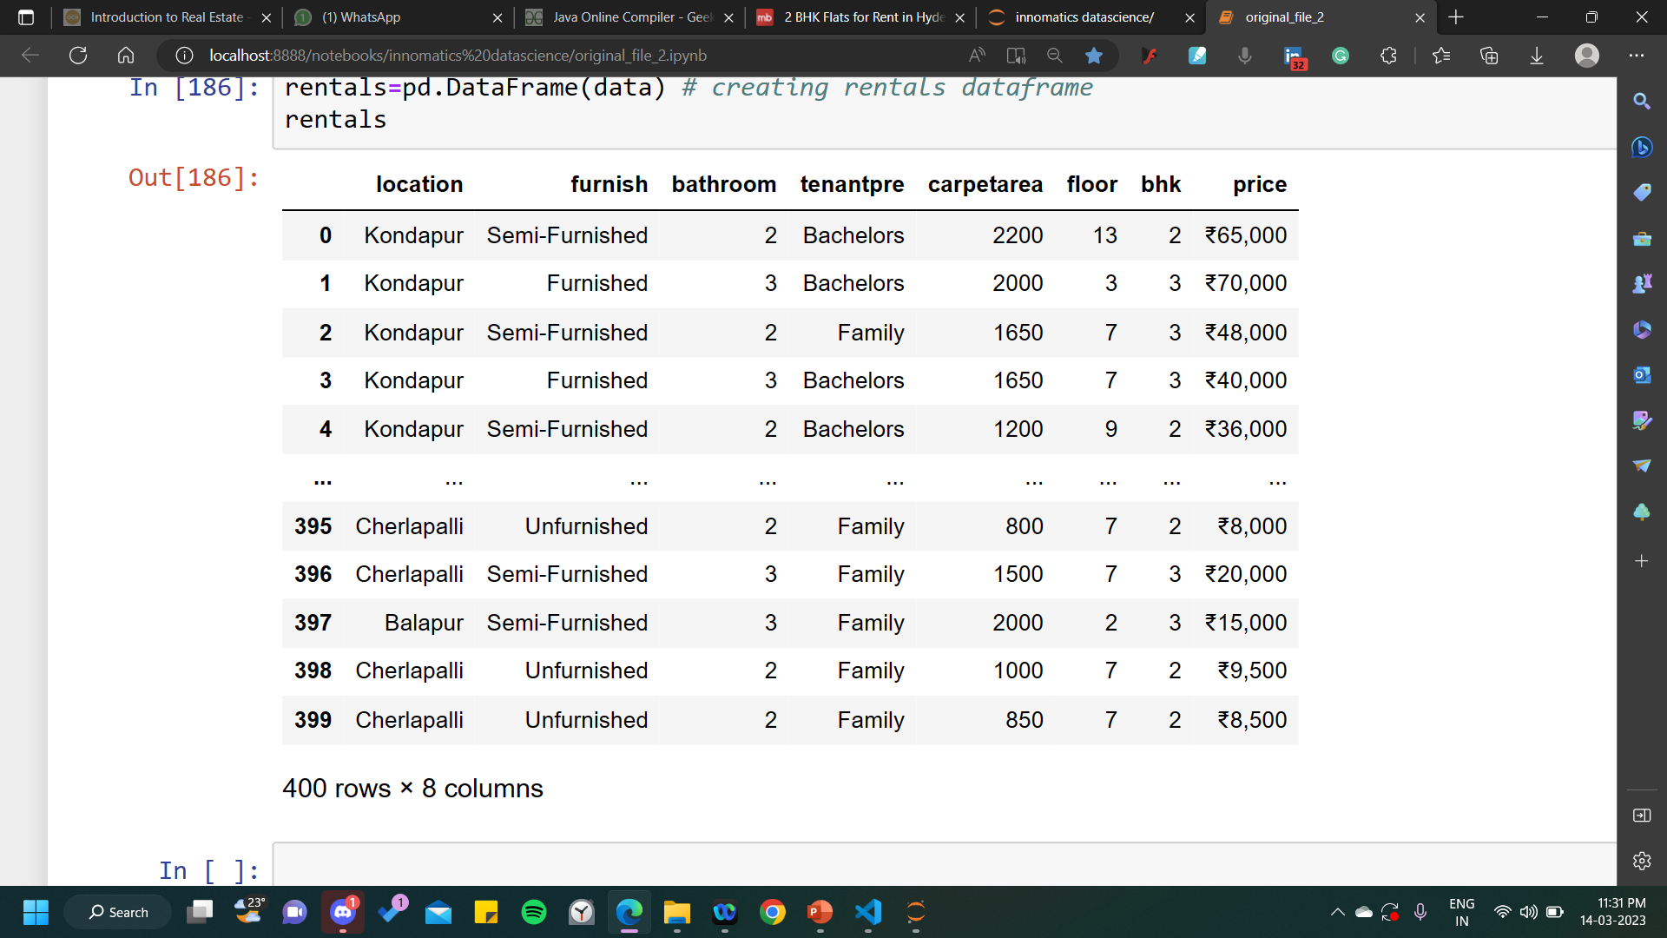
Raw data from website :
Insights : We have got 400 rows and 8 columns in the Raw data.

Slide 10
Data Cleaning Steps :
Data cleaning is the process of fixing or removing incorrect, corrupted, incorrectly formatted, duplicate, or incomplete data within a dataset.When combining multiple data sources, there are many opportunities for data to be duplicated or mislabeled. If data is incorrect, outcomes and algorithms are unreliable, even though they may look correct
STEP:1 Remove irrelevant observations
Here in our data we had mainly 3 irrelevant observations:
location column had special characters
price column had special characters like ₹,Lac
price column had different data type(float) which could lead to more outliers
STEP:2 Fix structural errors
We had several naming conventions, typos, or incorrect capitalization
STEP:3 Filter unwanted outliers
We have removed unwanted outliers
STEP4:Handle missing data
We have replaced missing data with nan and used imputation method also.
STEP5: Validate and QA
At the end of the data cleaning process, you should be able to answer these questions as a part of basic validation:
Does the data make sense?
Does the data follow the appropriate rules for its field?
Does it prove or disprove your working theory, or bring any insight to light?
Can you find trends in the data to help you form your next theory?

Slide 11
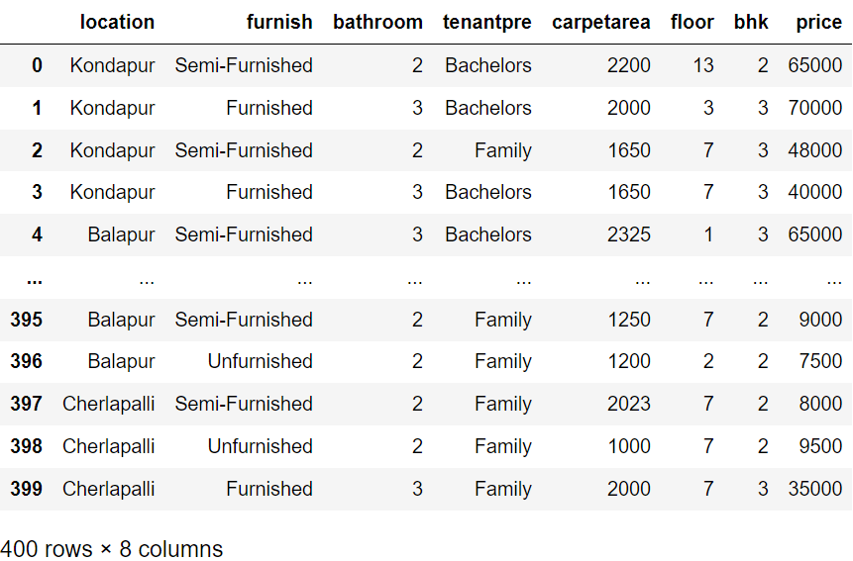
Cleaned Dataframe :

Slide 12
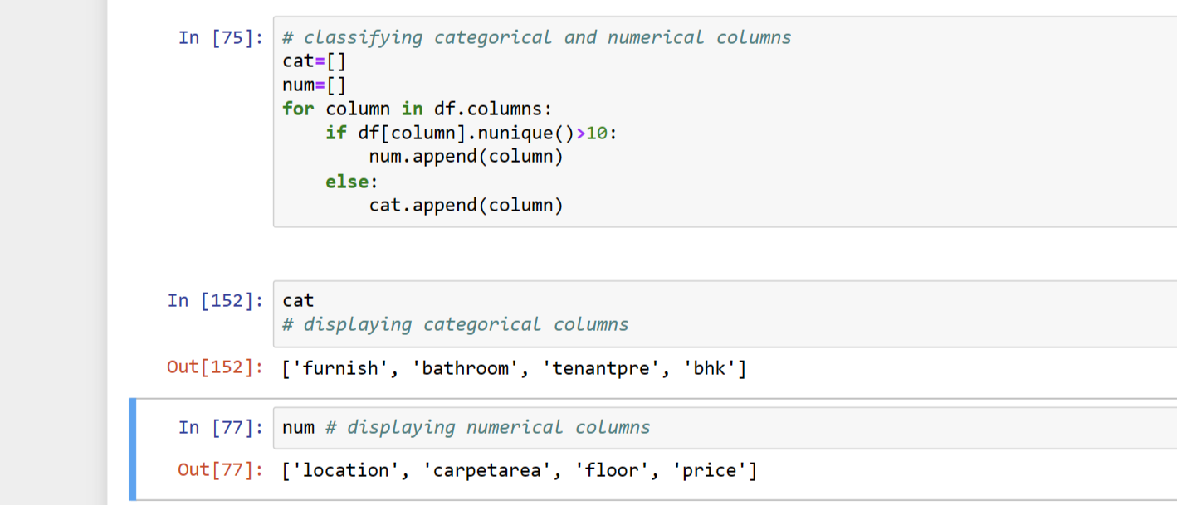
Classification of Continuous and Categorical Data :

Slide 13

Data Visualization :

Slide 14
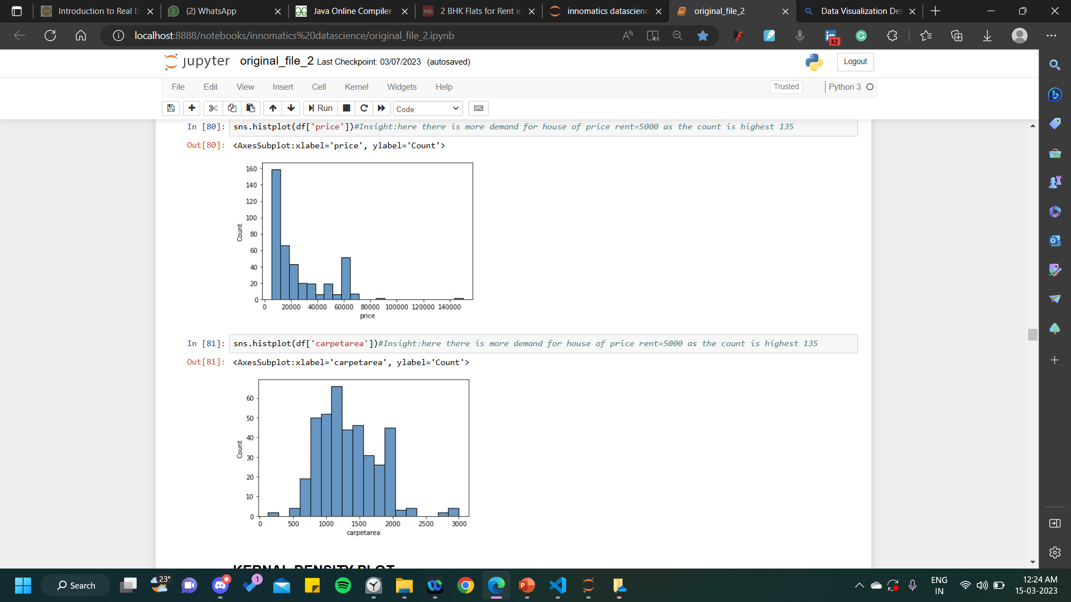
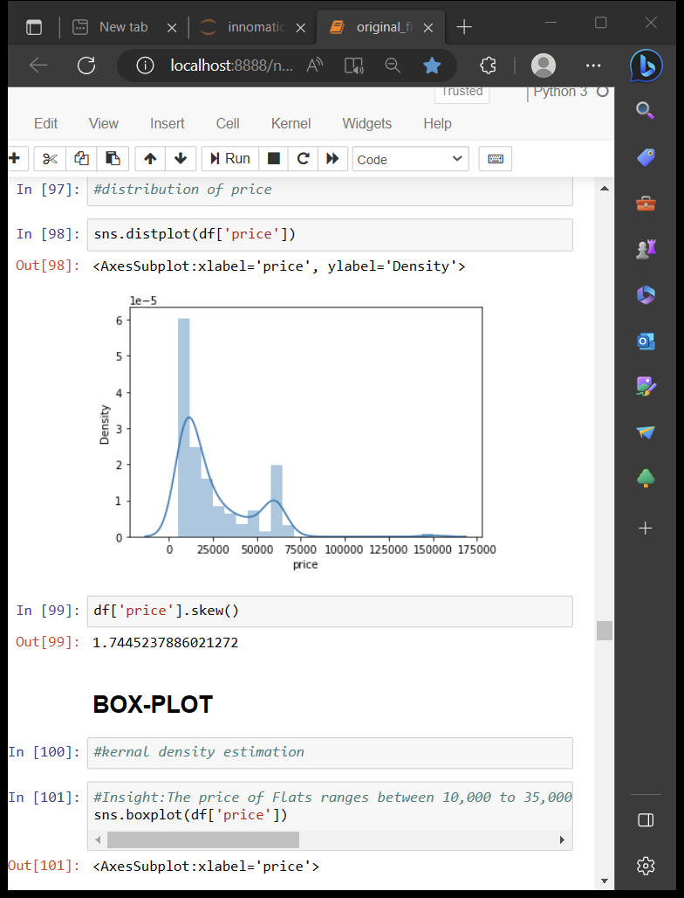
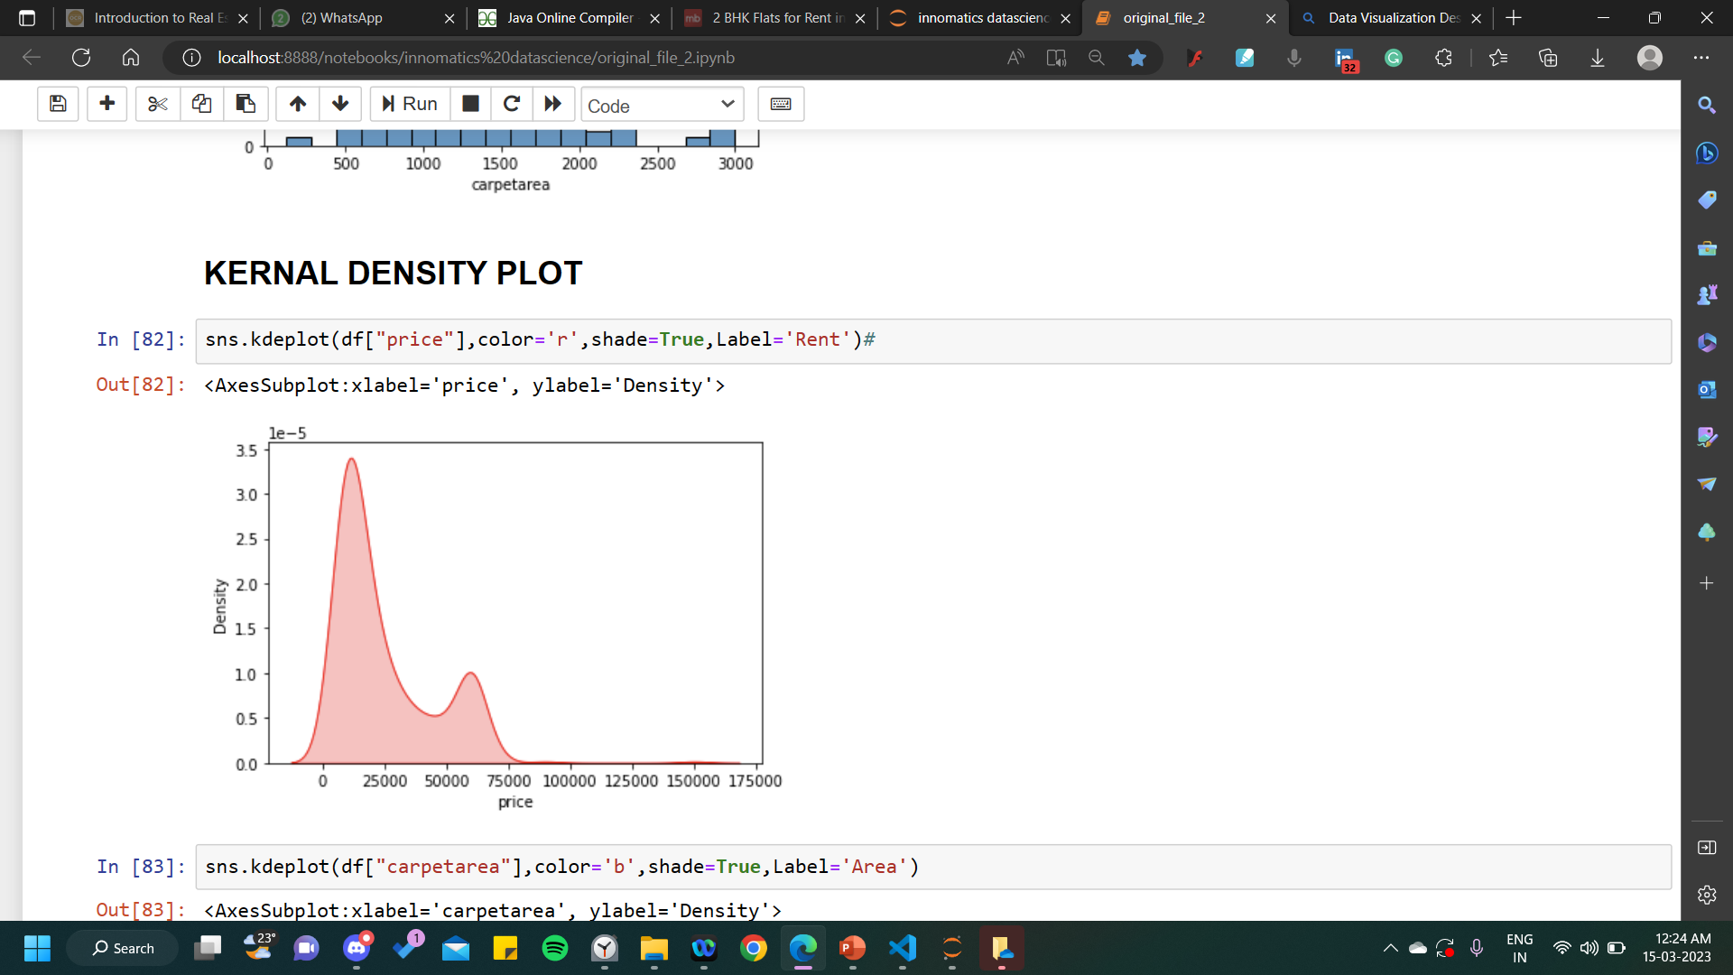
OBSERVING PRICE
PRICE VS COUNT
PRICE VS DENSITY
INSIGHTS:
here there is more demand for house of price rent=5000 as the count is highest 135
INSIGHTS:
Price maximum density at Price 17000,the curve increases from 0 to 17000 and then falls gradually

Slide 15
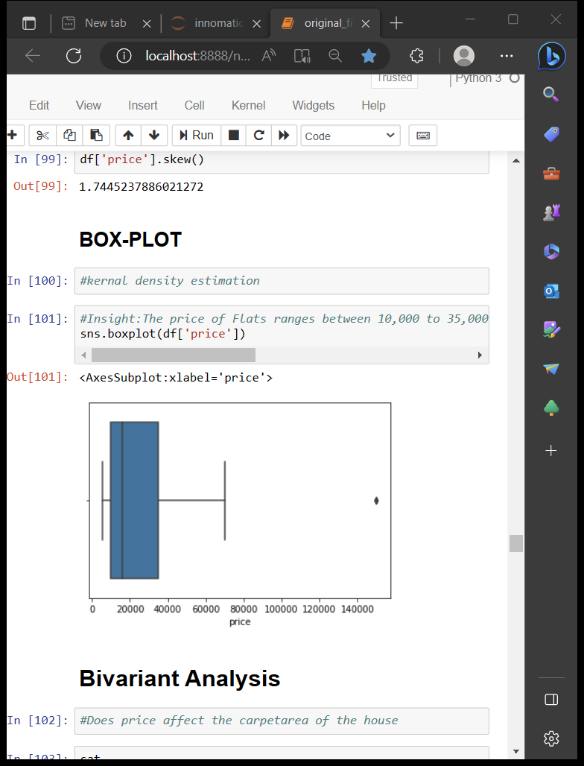
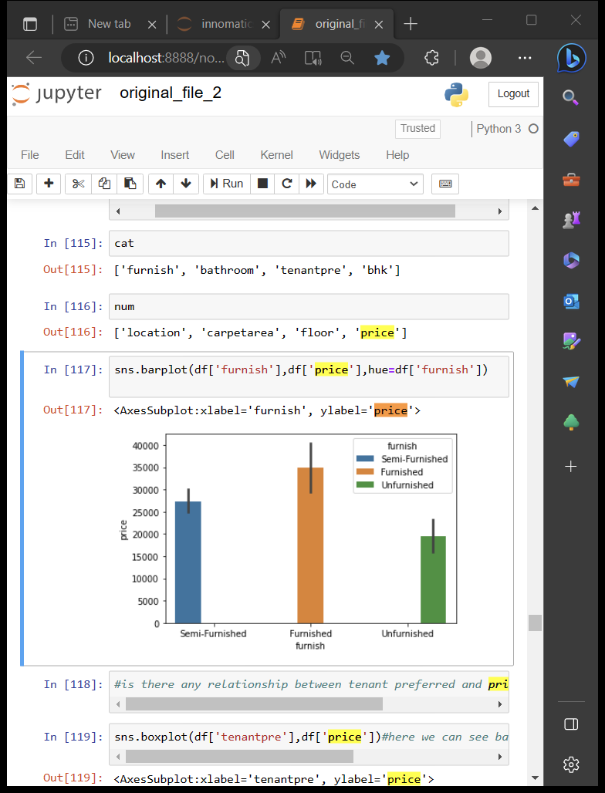
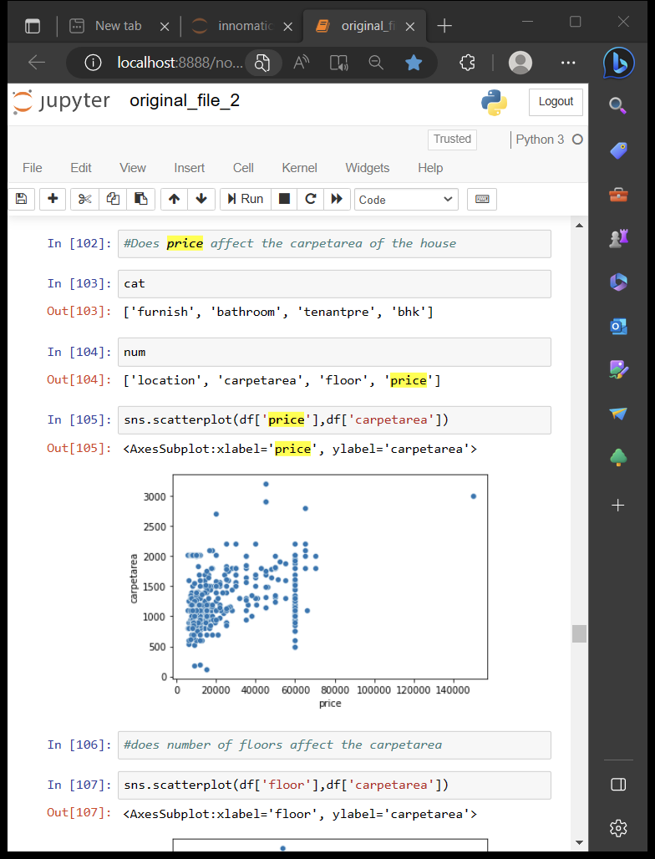
OBSERVING PRICE
PRICE
PRICE VS FURNISH
PRICE VS CARPET AREA
INSIGHTS:
This scatter plot shows linearity, so as the price increase carpet area also increases
INSIGHTS:
The price of Flats ranges between 10,000 to 35,000 quartiles the median quartile 15,000 and the outlier is out of range 1,50,000
INSIGHTS:
Furnished flats have the highest price

Slide 16
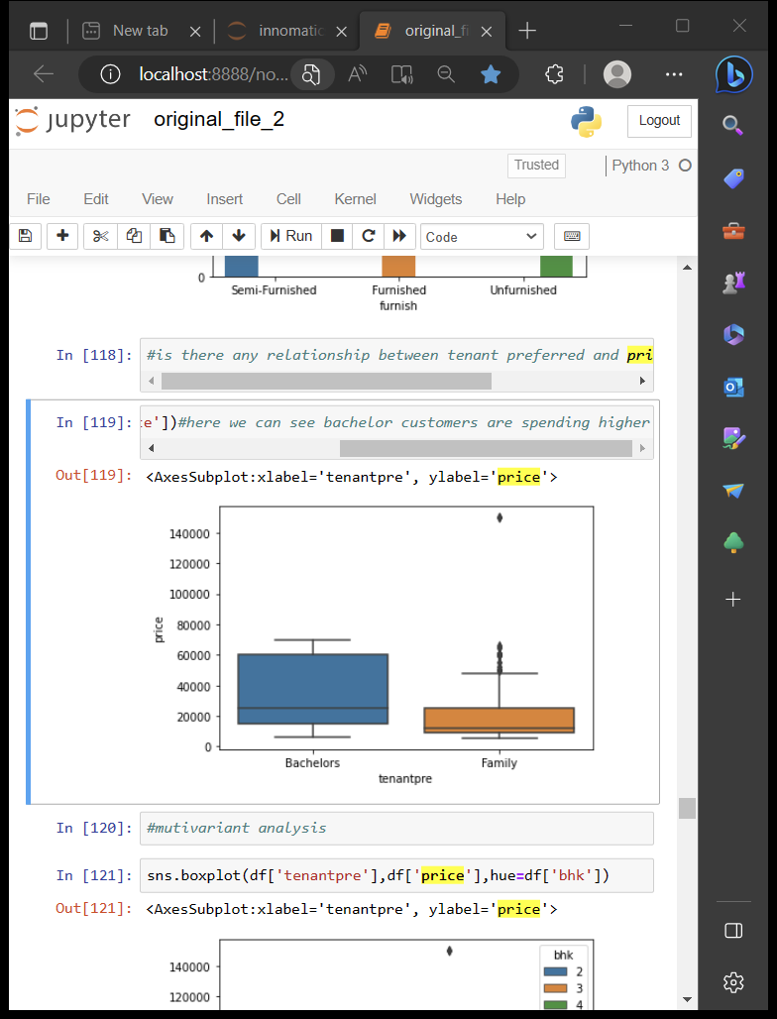
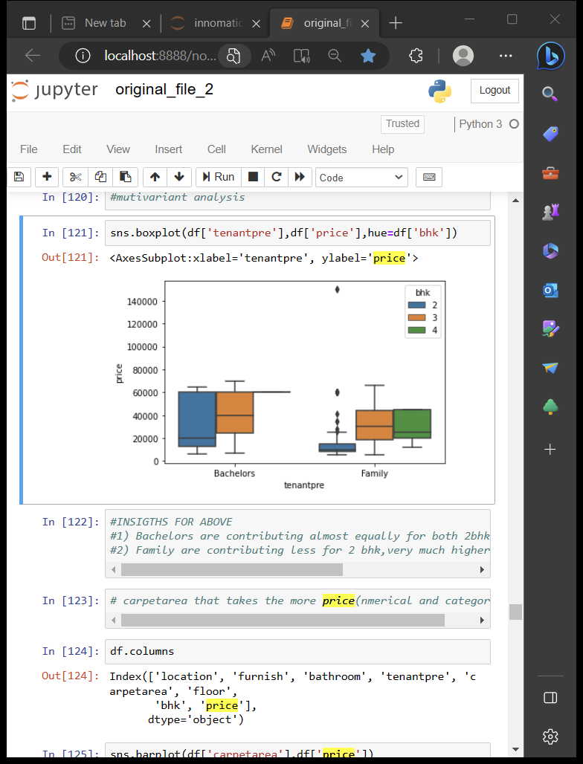
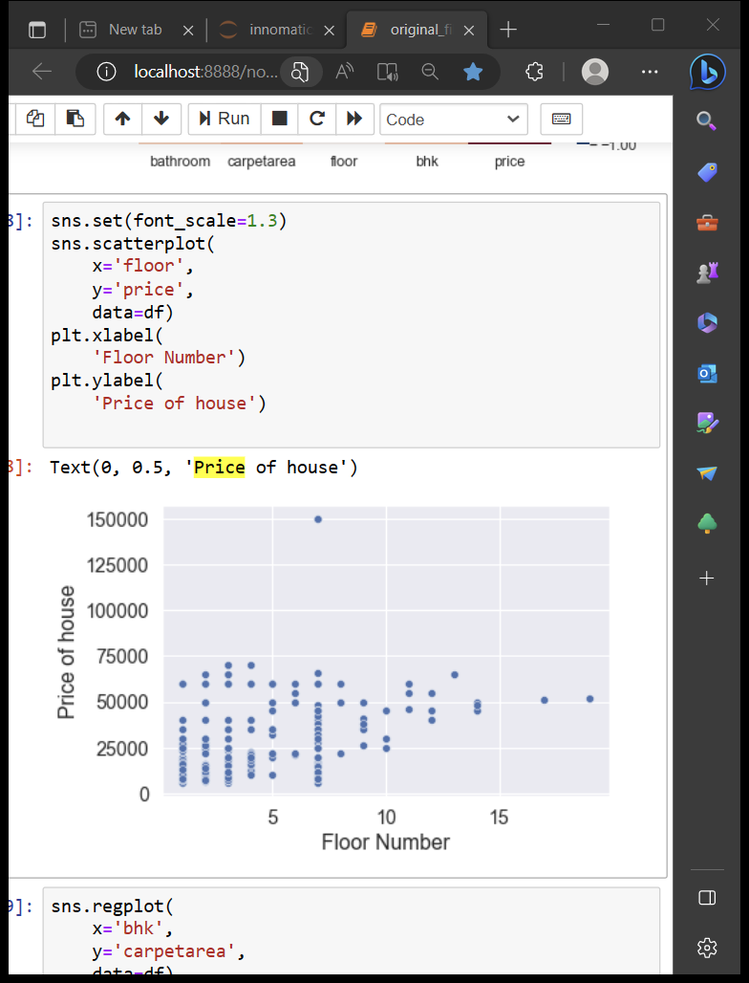
OBSERVING PRICE
PRICE VS TENANT PREFFERED
PRICE VS FLOOR
INSIGHTS: For bachelor are the price higher
INSIGTHS:
1) For Bachelors the price is almost equal for both 2bhk ad 3bhk
2) For Family the price is less for 2bhk,very much higher for 3bhk and little higher for 4bhk
INSIGHT:
7th floor flats more available for rents and it have most carpet area also

Slide 17
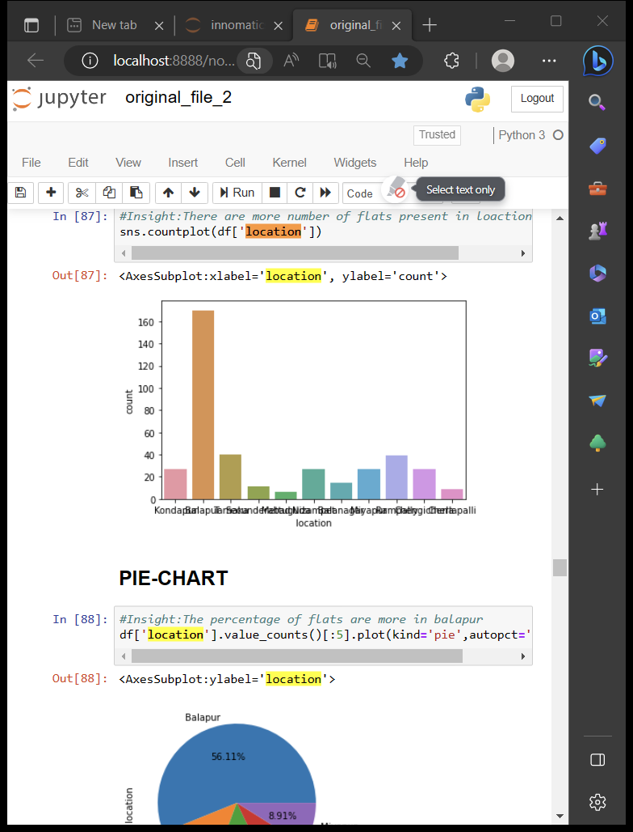
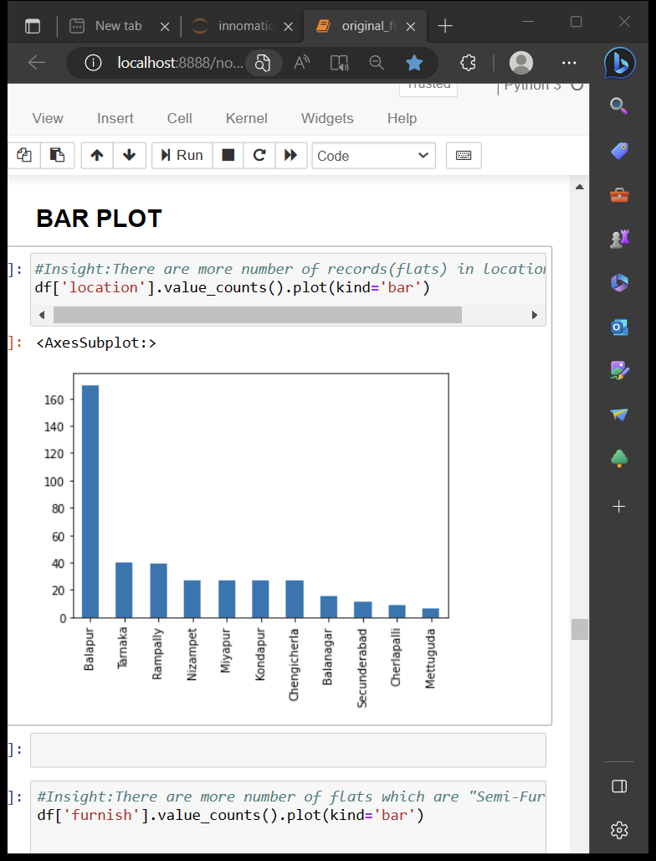
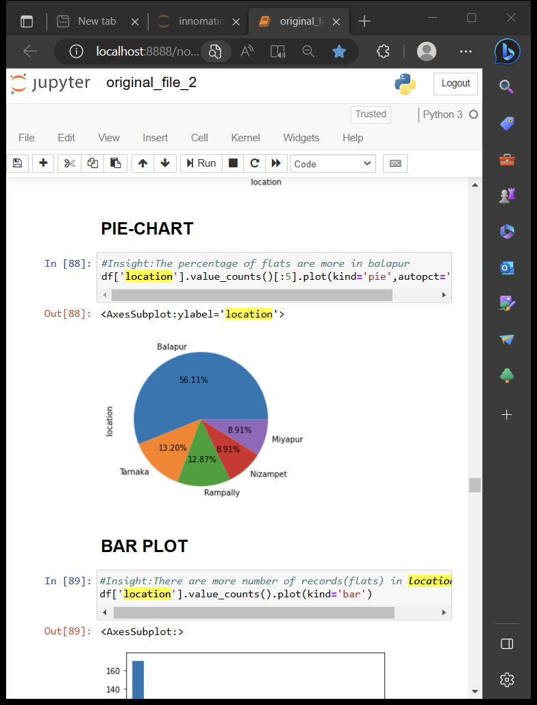
OBSERVING LOCATION
LOCATION VS COUNT
INSIGHTS:
There are more number of flats present in location Balapur
INSIGHTS:
The percentage of flats are more in Balapur
INSIGHTS:
number ofrecords(flats)inlocation: Balapur

Slide 18
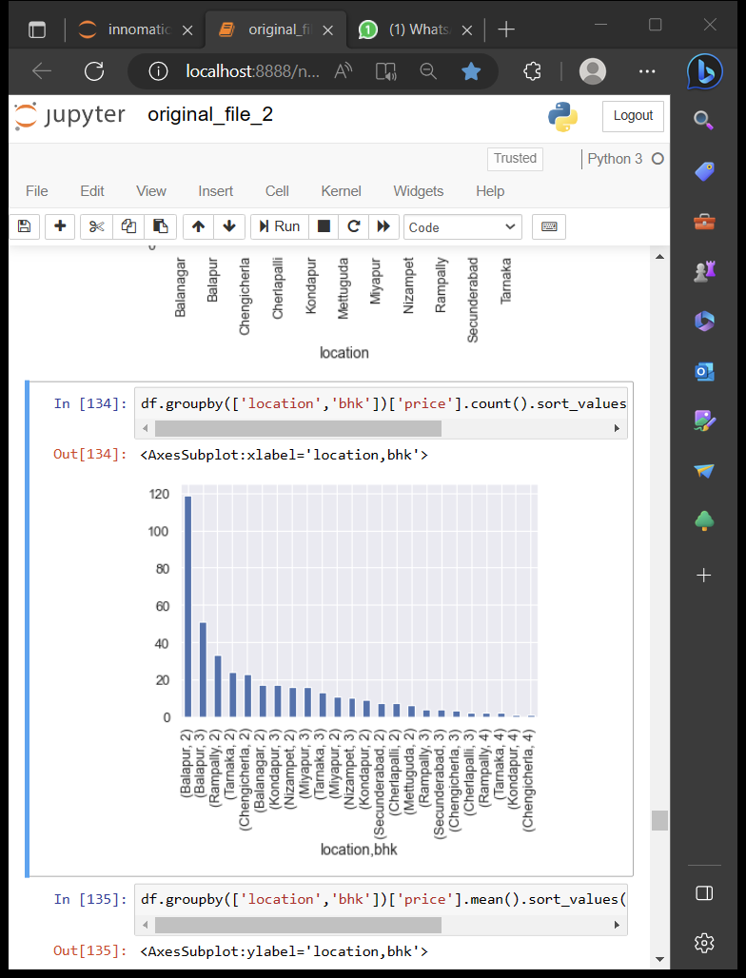
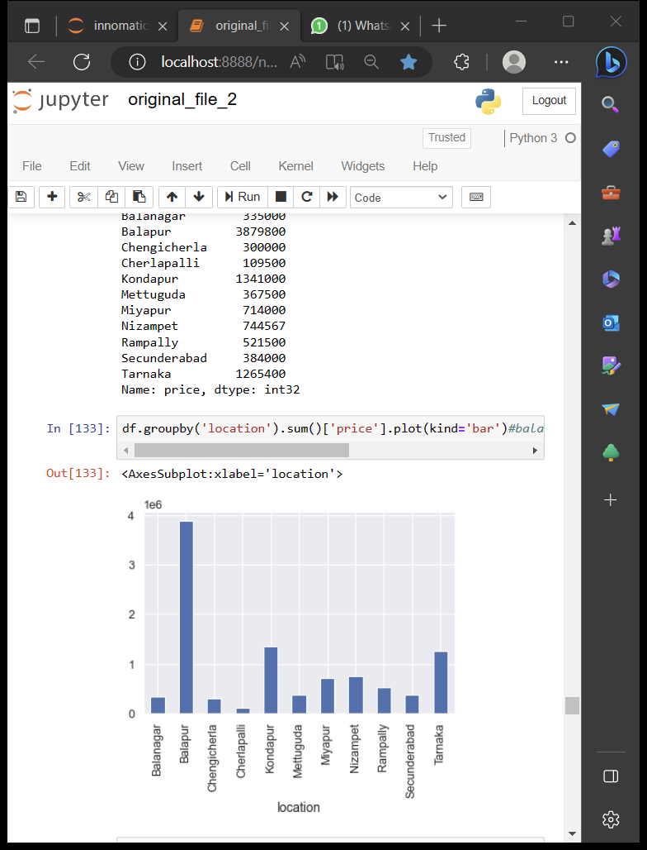
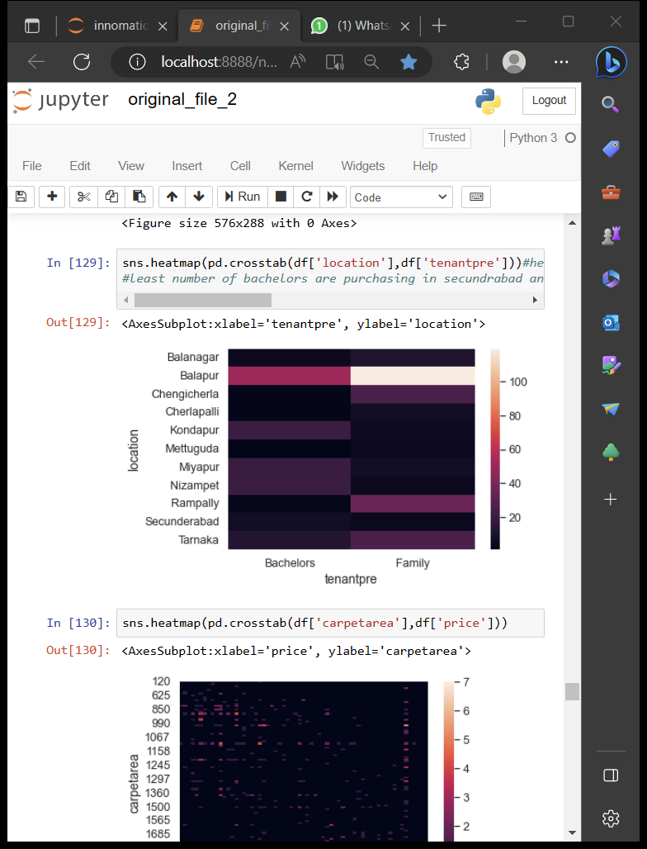
OBSERVING LOCATION
LOCATION VS PRICE
[LOCATION,BHK] VS PRICE
LOCATION VS TENANT PREFERRED
INSIGHT:
For families most of houses are available in balapur and least number for families in Secundrabad
#least number for bachelors in secundrabad and Rampally,more flats are available for bachelors in balapur
INSIGHT :
Balapur has more flats location with highest price
INSIGHT :
Balapur has more 2BHK flats in location with highest price

Slide 19
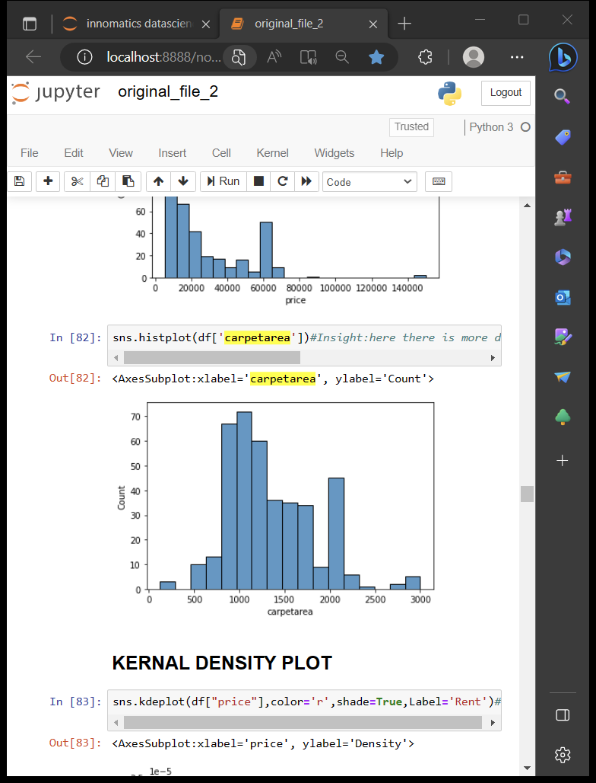
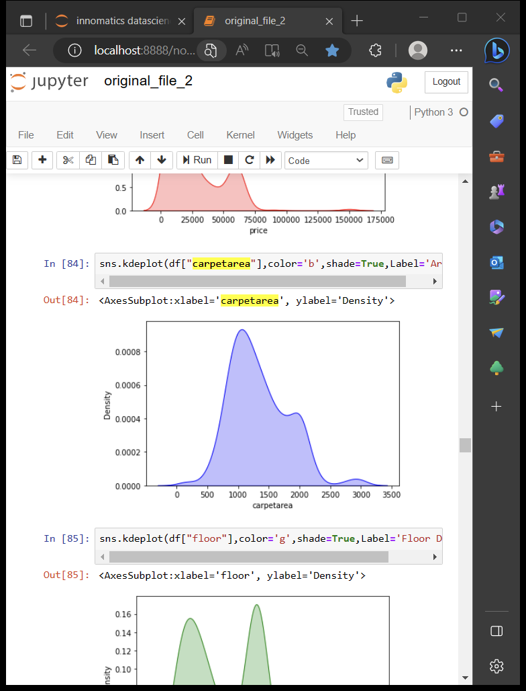
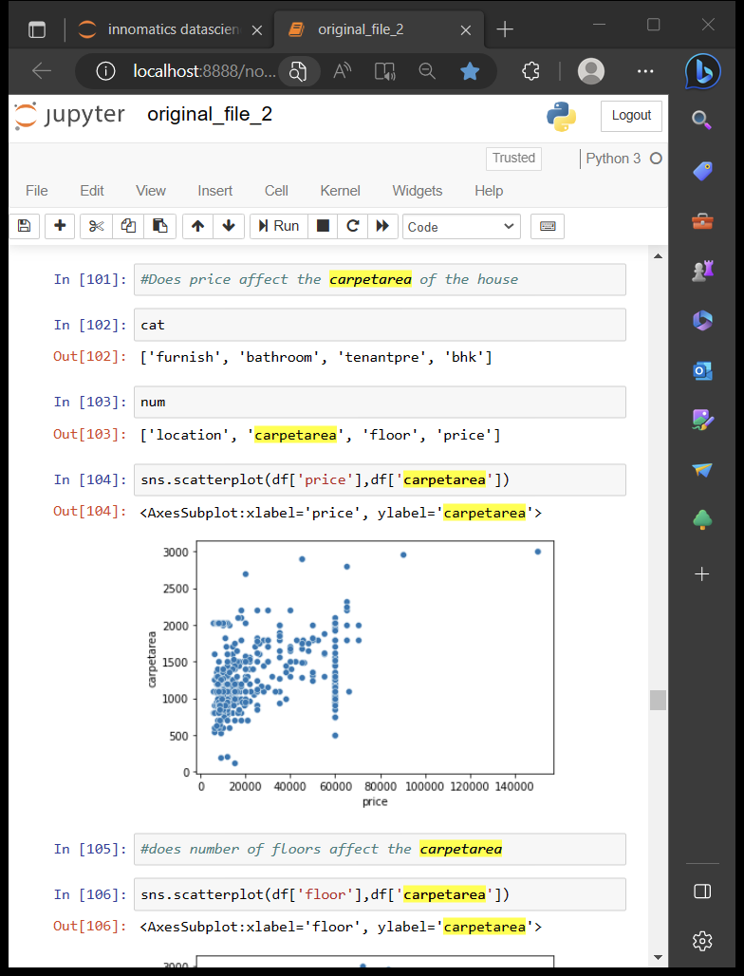
OBSERVING CARPET AREA
CARPET AREA VS COUNT
INSIGHT:
There more number of flats with carpet area 1100
INSIGHT:
The density of carpetarea increases from 0 to 0.0008 reaches max at 1100 and gradually decreases
INSIGHT:
This scatter plot shows linearity, so as the price increase carpet area also increases

Slide 20
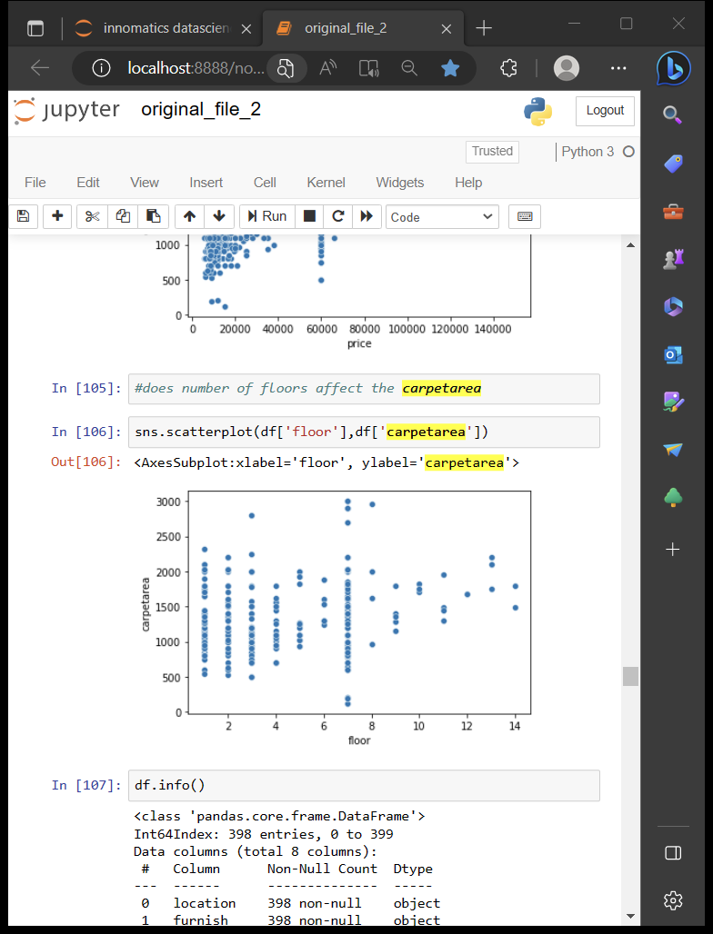
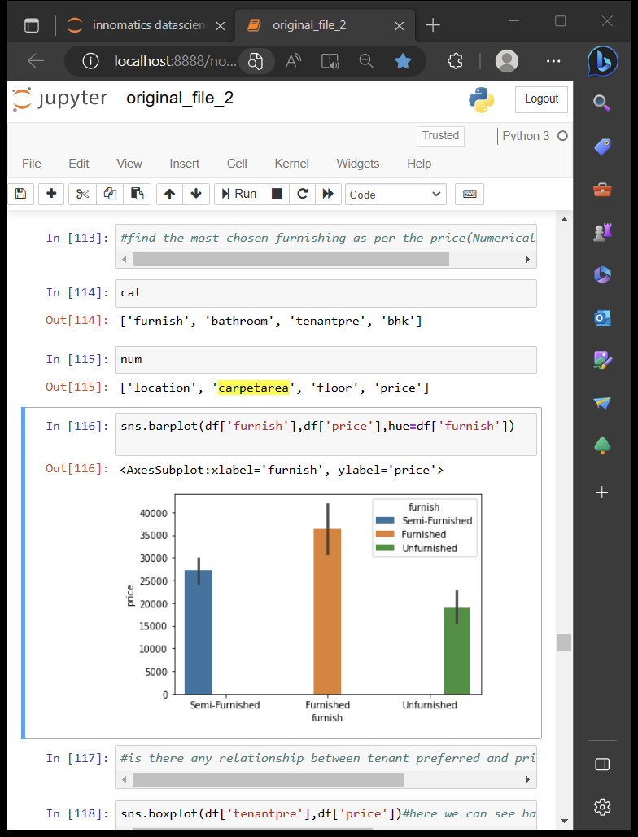
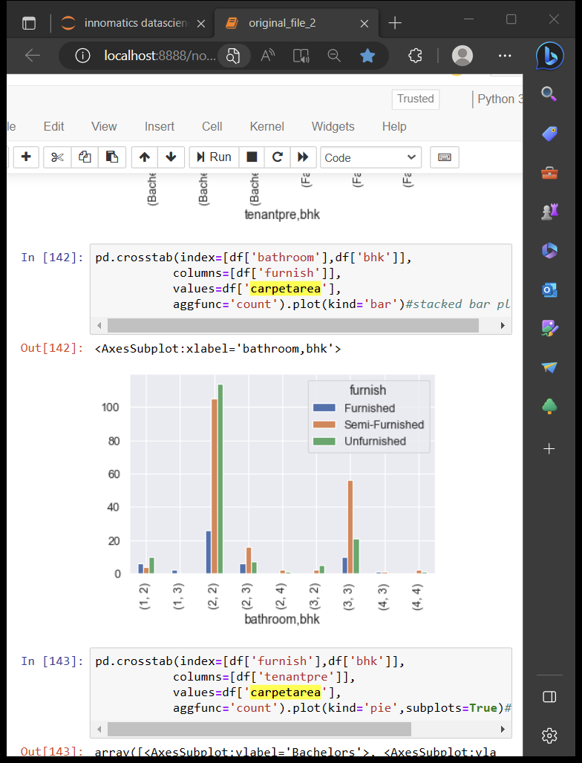
OBSERVING CARPET AREA
INSIGHT:
7th floor flats more available for rents and it have most carpet area also
INSIGHT:
The price is highest for flats which are furnished
INSIGHT:
There are more number of 2 bathroom,2 bhk houses which are unfurnished ,semi-furnished ,furnished respectively

Slide 21
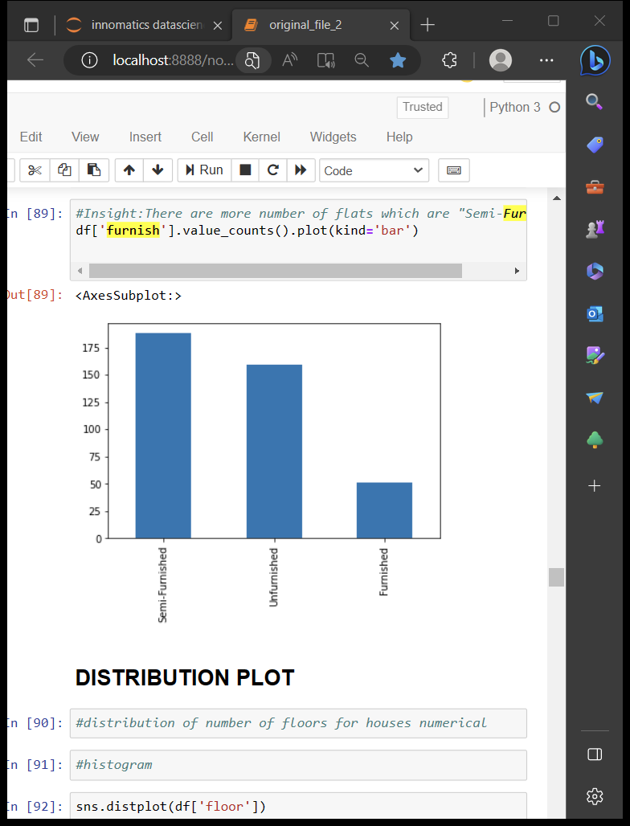
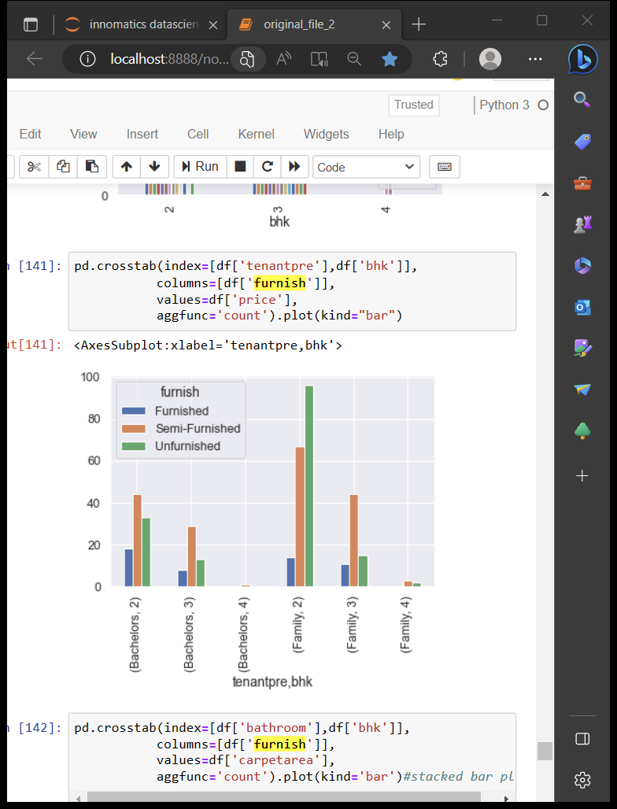
OBSERVING FURNISH
INSIGHT:
There are more number of 2 bhk houses which are unfurnished ,semi-furnished ,furnished respectively for families
INSIGHT:
There are more number of flats which are Semi-Furnished

Slide 22
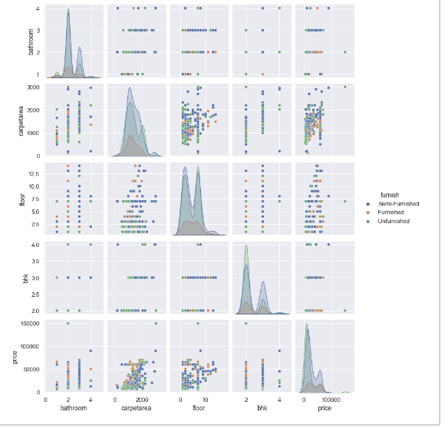
OBSERVING FURNISH
pair plot:
1.Having 2bathrooms is semifurnished
2.Having more carpetrea is also a semifurnished
3.Heighest floor is also semifurnished
4. 4bhk is unfurnished
5.Heighest priced house is a semifurnished

Slide 23
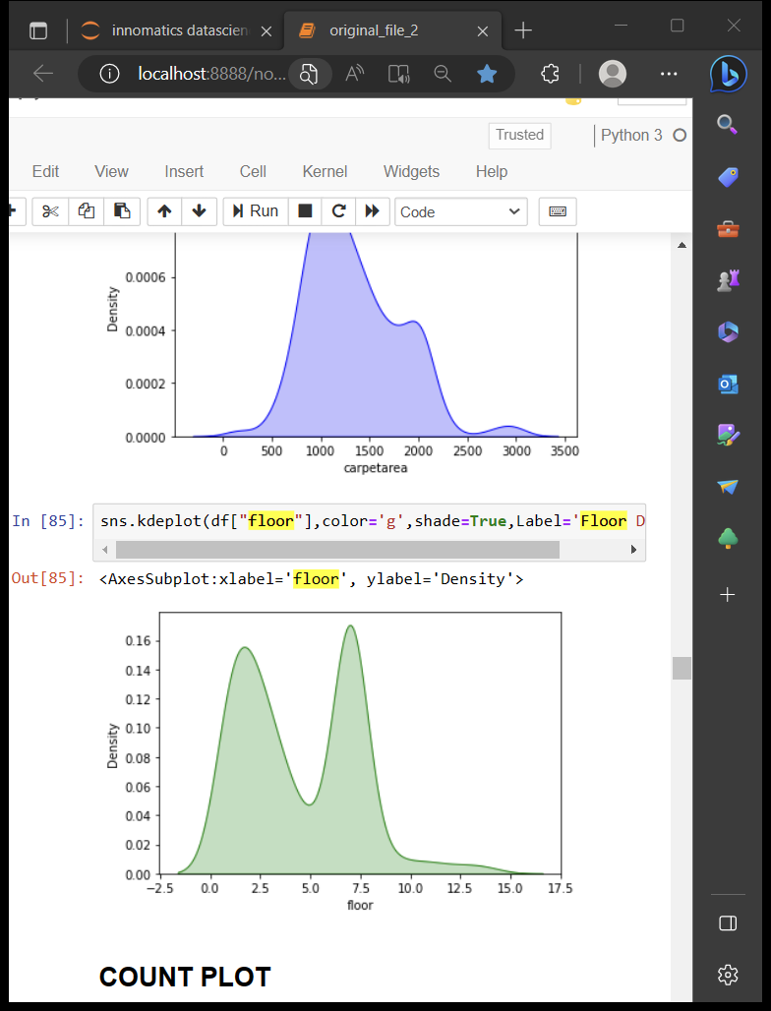
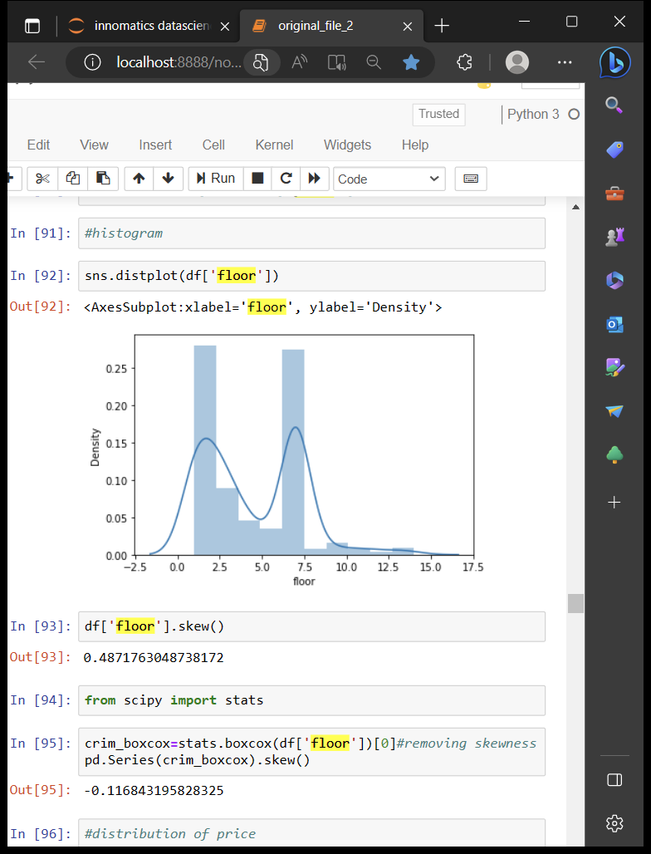
OBSERVING FLOOR
Insight:The density of floor increases from 0 to 0.15 reaches max at 1.75 and max at 6.5 at gradually decreases
INSIGHTS:
Price maximum density at floor 1.5 and floor 6.5,the curve increases from 0 to 0.15 and then falls gradually

Slide 24
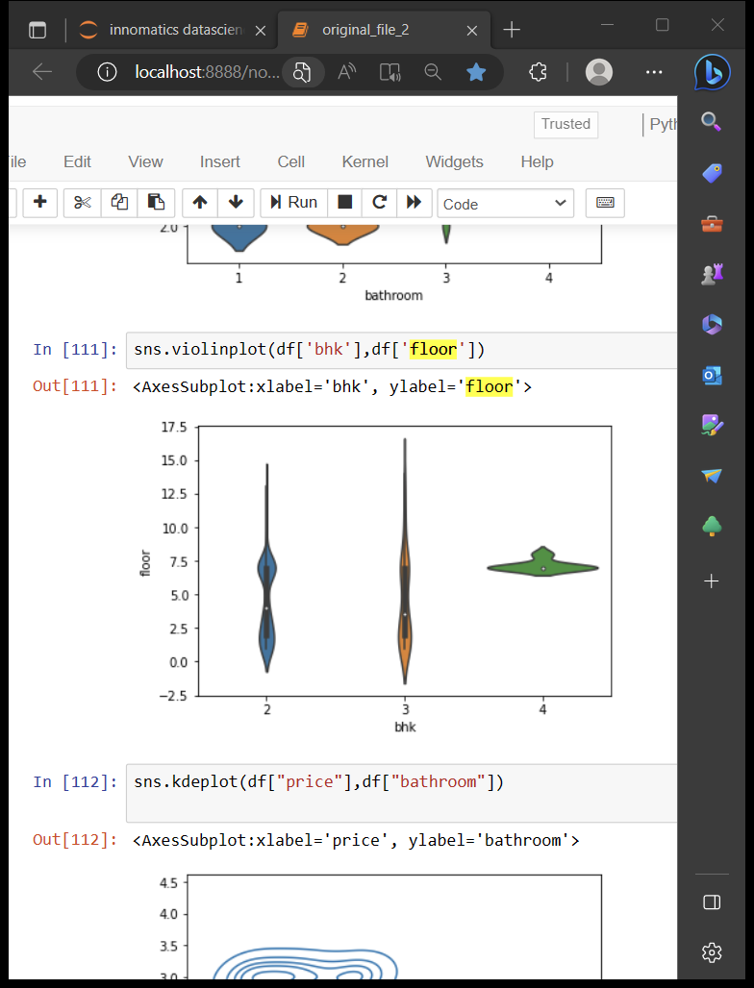
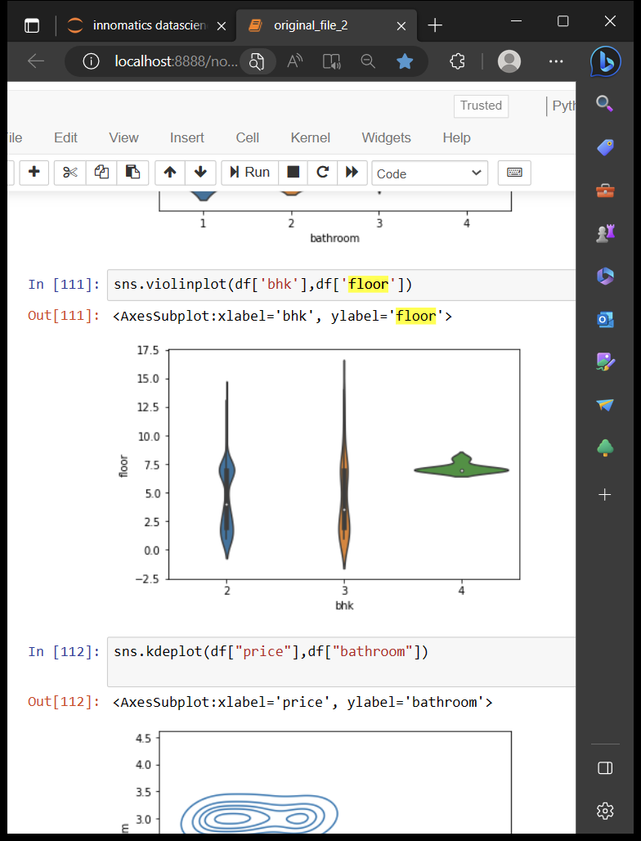
OBSERVING FLOOR
INSIGHT:
Meadian of 2,3bhk is in 3.5 foor and 2,3,4 bhk is more vailable in 7th floor

Slide 25
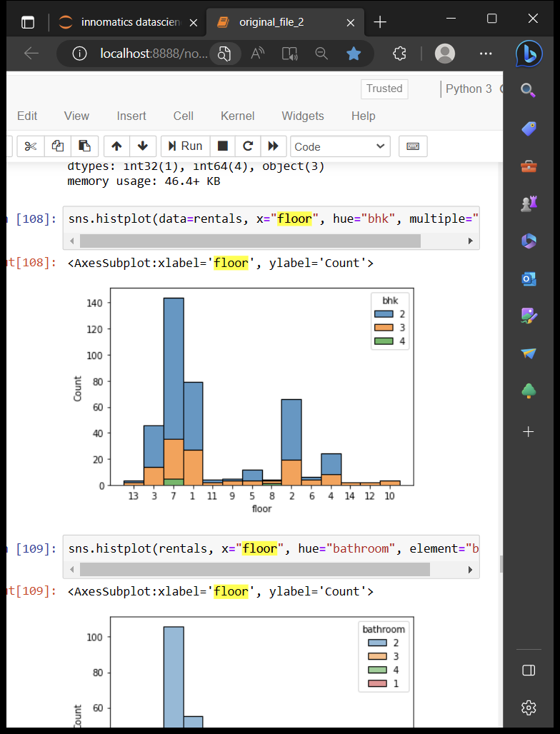
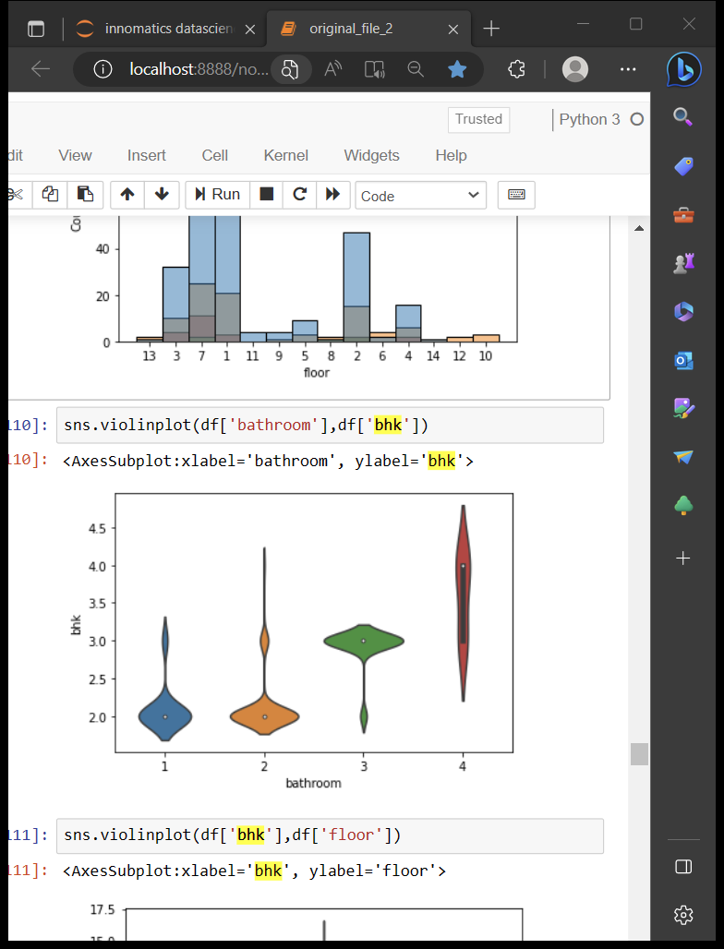
OBSERVING BHK
LOCATION VS COUNT
Insight:There are more number of floors present in loaction "Balapur"
Insight:
only 2bhk have 1 or 2 bathrooms and 3bhk have 3,4 bathrooms

Slide 26
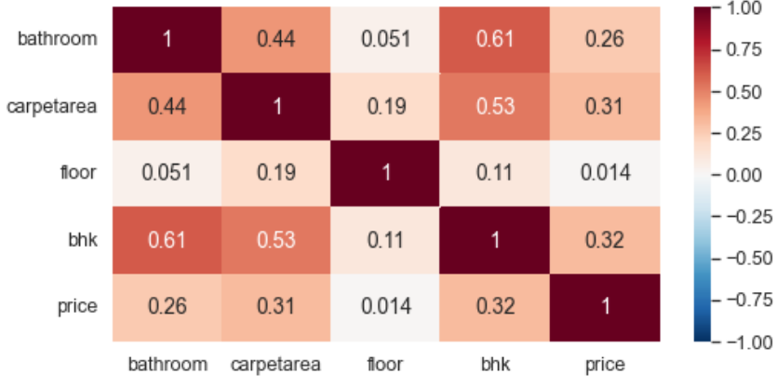
OBSERVING BHK
Heat plot:
1. increasing bhk is lead to increase price,bathroom,carepetarea
2. As floors increase price decreases

Slide 27
Challenges faced :
Finding the website is itself a big challenge for us, finally we have found magicbricks.
We need to scrap the data of every location in hyderabad, So there is huge work to take the data from the website.
This website is having scrolldown pages , so we decided to give all locations in a list
Removed special charecters and null values

Slide 28
Conclusions:
WE HAVE SUCCESSFULLY COMPLETED THIS DATA ANALYSIS ON MAGIC BRICKS REAL ESTATE WEBSITE:
Our Learnings are:
We can say the location BALAPUR has more houses available for tenants.
The mean of the price is least for Cherlapalli 2BHK flats and highest for Mettuguda 2BHK flats
There are more number of UnFurnished flats of 2BHK and these are available for families
Here more number of houses are available for families in balapur and least number of houses are available for families in Secundrabad and Rampally , most houses are available for bachelors in balapur
For Bachelors the price is almost equal for both 2bhk ad 3bhk
For Family the price is less for 2bhk,very much higher for 3bhk and little higher for 4bhk
The price of Flats ranges between 10,000 to 35,000 quartiles the median quartile 15,000 and the outlier is out of range 1,50,000

Slide 29


